Slide 1

GLOBAL ACADEMY OF TECHNOLOGY DEPARTMENT OF COMPUTER SCIENCE AND ENGINEERING
Subject Name | Major Project Work Phase II | Subject Code | 22CSEP76
Student Name | Harshitha N. K. | USN | 1GA22C071
 | Shreya N. |  | 1GA22C153
 | Swara Shetty M. |  | 1GA22C173
 | Swathi K. N. |  | 1GA22C174
Domain | Internet of Things (IOT) | Group No: | 51
Project Title | “Next-Generation Waste Management: A Smart, Sensor-Based and Community-Driven Approach”
Undertaken at | Global Academy of Technology
Guide Name | Prof. Shwetha N

Slide 2
Agenda
Introduction
Problem Statement
Objectives
Literature Survey
Architecture
Proposed Solution
Requirement Specifications
Demo
References
Bibliography

Slide 3
Introduction
The Internet of Things (IoT) is a growing technology domain that enables devices to communicate and act autonomously through sensors and network connectivity.
In urban waste management, IoT offers powerful solutions for automation, monitoring, and real-time data collection.
It addresses challenges like inefficient waste segregation, delayed collection, and poor visibility in waste tracking and reporting.
Smart bins, tracking-enabled vehicles, and sensor-driven systems are becoming integral parts of sustainable urban infrastructure.

Slide 4
Problem Statement
Urban areas face increased waste generation, overwhelming traditional collection and segregation methods.
Lack of real-time monitoring and tracking leads to issues like overflowing bins and illegal dumping.
Limited public participation and absence of digital reporting systems hinder timely resolution of waste-related issues.

Slide 5
Literature Survey
Title and author | Scope/SCI Date of Publication | Dataset and methodology used | Research gap identified/ limitation
Innovative Waste Management: The Efficiency of IoT-Enabled Smart Bins (2024)- Shiva Mehta, Abhinav Rathour | IEEE ICCPCT (Scopus), 2024 | Real-time monitoring using ultrasonic, temperature, tilt, and weight sensors; pilot study over 6 months | Sensor calibration issues and scalability in high-density zones; long-term environmental impact assessment limited
An IoT-based Smart Waste Disposal and Credibin Rewards System for Sustainable Campus Waste Management K.S. Abishek et al. | IEEE (Scopus indexed)ICEARS 2025 | Real-time sensor data from ultrasonic & weight sensors; barcode-based user ID; cloud integration; reward system | Lack of intelligent reward integration in campus systems; existing systems are manual with no incentive mechanism or anomaly detection

Slide 6
Literature Survey
Title and author | Scope/SCI Date of Publication | Dataset and methodology used | Research gap identified/ limitation
Waste Management Scheduling Using Optimization and Decision Support Algorithms- Jayson A. Batoon et al. | Scopus August 2024 (ICSGRC Conference) | Mobile-based truck scheduling, GPS tracking, decision-support algorithms (queuing, optimization) | Most current platforms lacked integration of real-time tracking, scheduling optimization, and social engagement features
IoT-Enabled Intelligent Garbage Management System for Smart City- Md. Arafatur Rahman et al. | Scopus June 2024 | LoRa-based IoT system, CVRP optimization, Fairness-Based Optimum Solution (FBOS) | Prior works ignored fairness in vehicle routing for waste collection, leading to distance/time disparity among trucks

Slide 7
Literature Survey
Title and author | Scope/SCI Date of Publication | Dataset and methodology used | Research gap identified/ limitation
Garbage Monitoring System using IoT Mithun etal. | IEEE ICNWC (Scopus), 2024 | ESP32, ultrasonic sensor, GPS, GSM; mobile app for real-time alerts | Data security and sensor reliability in low-connectivity areas; effectiveness in high-density regions untested
IoT-Based Smart Waste Management System with Level Indicators Mary P. Vargheseetal. | IEEE ICDCECE (Scopus), 2024 | Smart bins with ultrasonic sensors, LoRa-based communication, GPS, and level indicators for segregation | Gateway placement and power optimization not fully addressed; simulation-based, lacks real-world deployment validation

Slide 8
Literature Survey
Title and author | Scope/SCI Date of Publication | Dataset and methodology used | Research gap identified/ limitation
A Smart Waste Management System with Optimized Routing Method Perumalla Dharan, V. M. Manikandan | IEEE (Scopus indexed)ICCCNT 2024 | Arduino MKR WiFi 1010, ultrasonic sensors, ML (PyVRP) for optimized route planning | Focuses on routing and fill-levels; lacks user engagement, reward strategies or multi-type waste separation
IoT-Based Smart System for Garbage Detection and Segregation Dr. M.V. Rajeshetal. | IEEE SILCON (Scopus), 2023 | Ultrasonic sensors, servo motors, moisture sensors, image processing for segregation | Limited by fixed threshold values; environmental sensor coverage (gas, humidity) not included; real-time segregation not validated

Slide 9
Literature Survey
Title and author | Scope/SCI Date of Publication | Dataset and methodology used | Research gap identified/ limitation
IoT-enabled Smart Waste Management: Leveraging the Power of IoT for Sustainable Solutions Righa Tandon, Abhishek Bansal | IEEE CISCT (Scopus), 2023 | Multi-layer architecture (IoT-Fog-Cloud), smart bins with various sensors (IR, ultrasonic, temperature), integration with WasteSense system for real-time alerts | High cost of deployment, limited scalability, security/privacy concerns, regulatory and stakeholder engagement challenges
A Smart-Dustbin and Integration of Waste Management Using IoT G.V.V.S.L. Rupesh et al. | Scopus 2022 (ICIRCA Conference) | IoT-based smart bins using NodeMCU, sensors for bin level detection, GSM/Wi-Fi for monitoring | Existing municipal systems often rely on manual schedules and do not have the capability to monitor the real-time status of waste bins, leading to overflowing garbage and inefficient cleaning cycles.

Slide 10
Objectives
To develop a comprehensive and user-friendly web application that enables users to report feed back and issues such as missed garbage collection and illegal dumping directly to municipal authorities for swift action.
To design and deploy an IOT based automated waste segregation system.
To contribute to environmental sustainability by reducing landfill dependency and encouraging responsible waste disposal habits among citizens through technological and community-driven approaches.
To implement an IoT-enabled tracking system that provides updates for garbage collection trucks and improving efficiency.

Slide 11
Architecture
Three-Layer Architecture
IoT Hardware Layer
Cloud Layer
Application / Dashboard Layer
IoT Hardware Layer
Smart dustbin with separate compartments for wet, dry, and metallic waste
Sensors used:
Ultrasonic – bin level detection
IR – object detection
Raindrop – wet waste identification
Proximity sensor – metallic waste detection
Microcontroller processes sensor data and controls segregation
Cloud Layer
Real-time data sent to ThingSpeak
Stores and visualizes bin level and waste-type data
Generates gauges and charts for dashboards
GSM module sends SMS alerts to drivers when bins are full

Slide 12
Architecture
Application / Dashboard Layer
Admin Dashboard
Views live bin status (ThingSpeak)
Manages drivers and views user feedback (Supabase)
User Dashboard
User login and registration (Supabase)
Map view of bin locations and segregation graphs
Feedback and reward system
Driver Dashboard
Driver login (Supabase)
Views bin status.

Slide 13
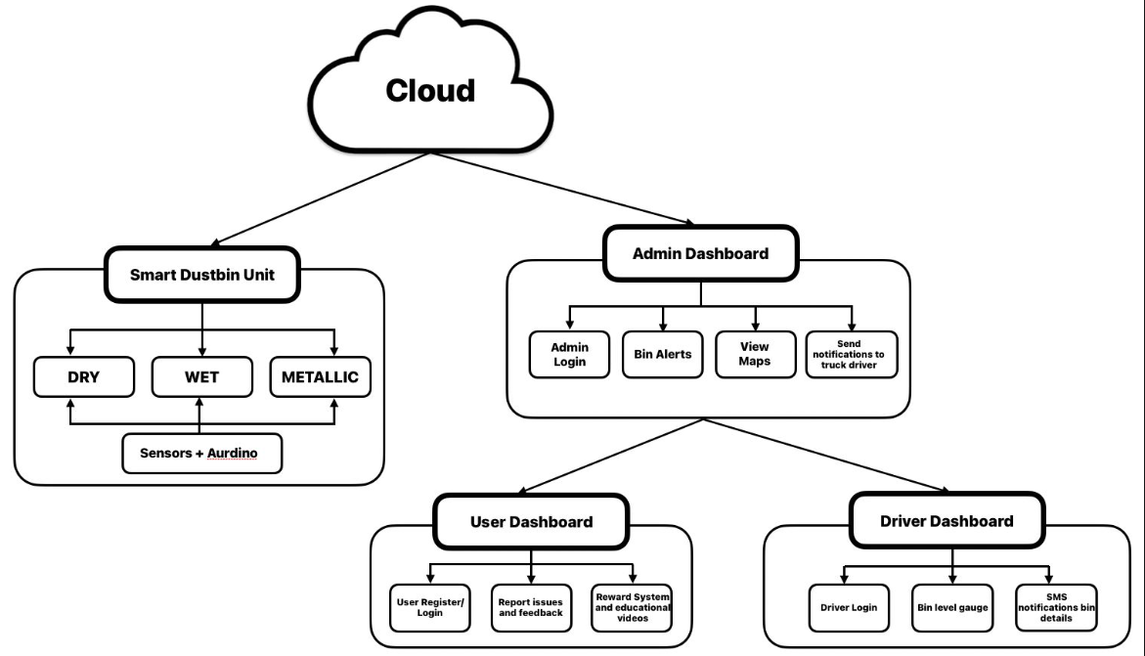
Sample Architecture

Slide 14
Algorithm designed for the Complete work
Algorithm 1: Waste Detection and Segregation Algorithm
Input: IR sensor, Metal sensor, Moisture sensor Output: Segregated waste (Dry / Wet / Metallic)
Start
Initialize IR, metal, and moisture sensors
Wait for object detection using IR sensor
If metal sensor detects metal → Rotate stepper motor to metallic bin
Else if moisture sensor detects wet waste → Rotate stepper motor to wet bin
Else → Classify waste as dry → Activate servo motor to open dry bin
Reset servo and stepper to default position
End

Slide 15
Algorithm designed for the Complete work
Algorithm 2: Segregation Mechanism Control Algorithm
Input: Waste type from sensors Output: Mechanical movement of bins
Start
Set stepper motor speed and direction
If waste is metallic → Rotate stepper motor anticlockwise
If waste is wet → Rotate stepper motor clockwise
Open servo flap to drop waste
Close servo flap after delay
Rotate stepper motor back to initial position
End

Slide 16
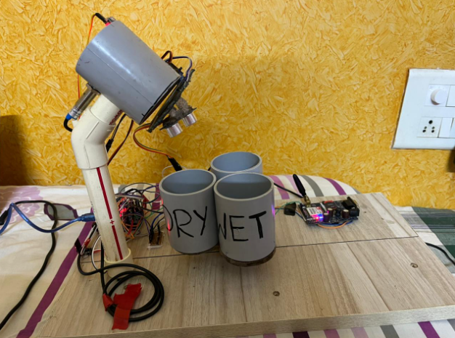
Results – Presentation & Demonstration
TEST CASE 1:

Slide 17
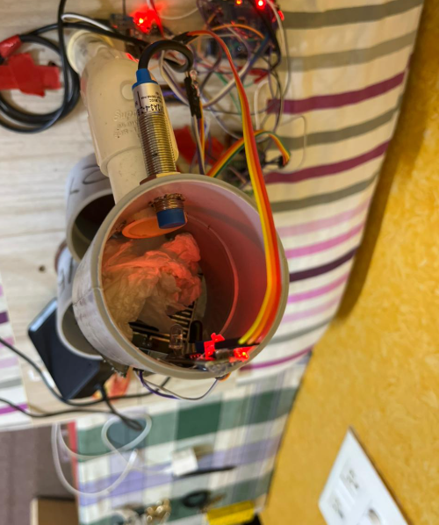
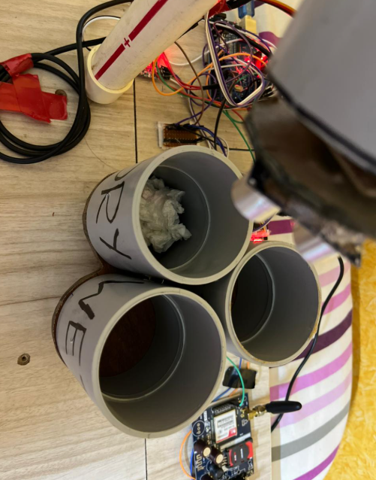
Results – Presentation & Demonstration
TEST CASE 2:

Slide 18
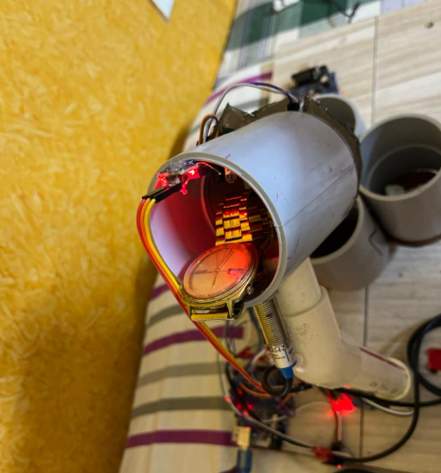
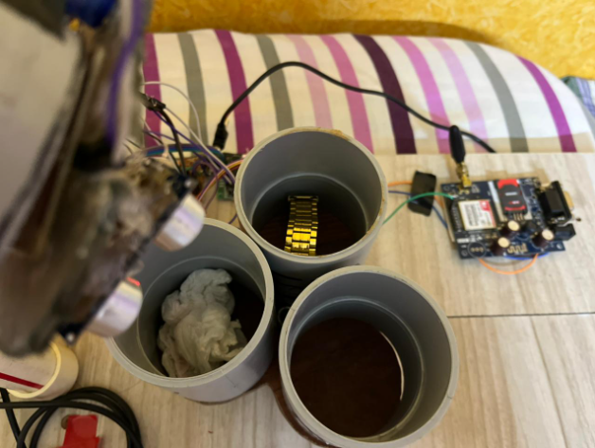
Results – Presentation & Demonstration
TEST CASE 3:

Slide 19
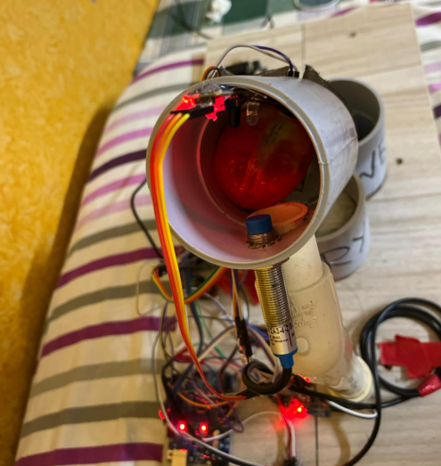
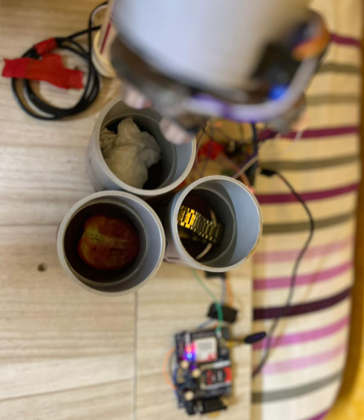
Results – Presentation & Demonstration
TEST CASE 4:

Slide 20
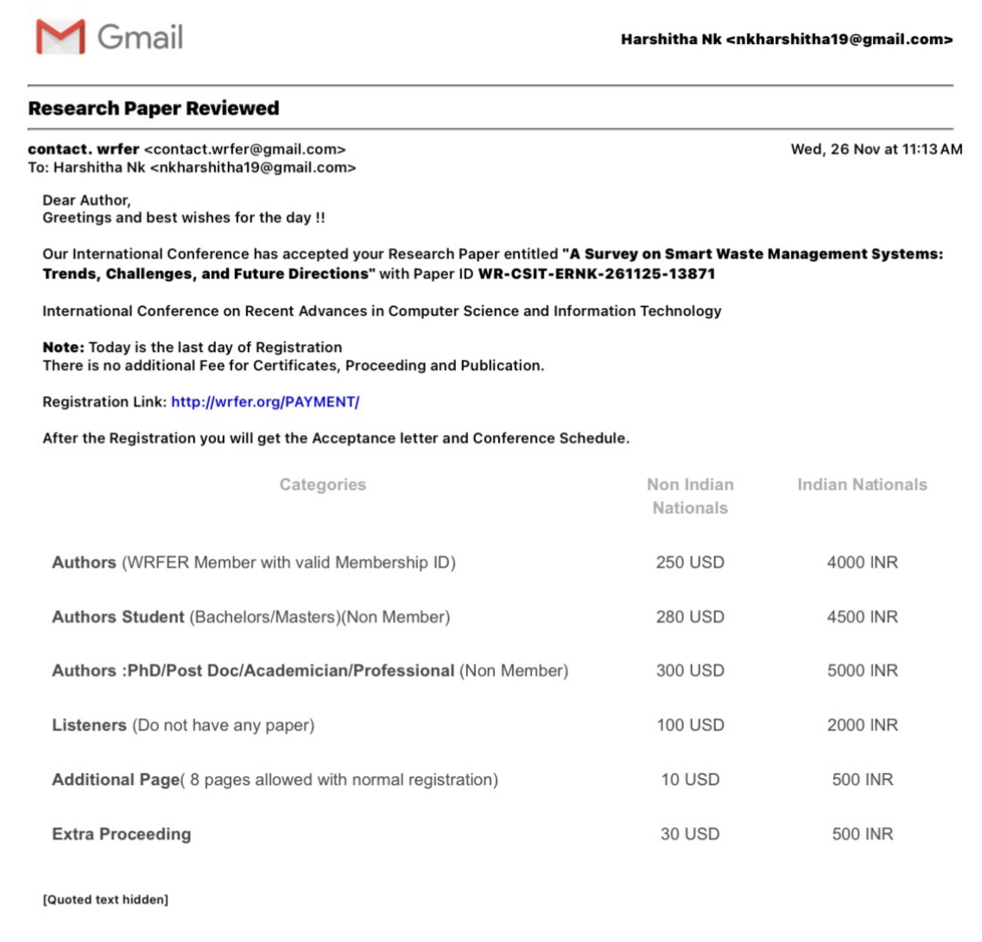
PROJECT WORK OR PAPER PUBLICATIONS

Slide 21
References
S. Mehta and A. Rathour, "Innovative Waste Management: The Efficiency of IoT-Enabled Smart Bins," 2024 7th International Conference on Circuit Power and Computing Technologies (ICCPCT), Kollam, India, 2024, pp. 467-471, doi: 10.1109/ICCPCT61902.2024.10672653. keywords: {Waste management;Costs;Urban areas;Systems architecture;Carbon dioxide;Real-time systems;Software;Smart Cities;Waste Management;Internet of Things (IoT);Ultrasonic Sensors;Embedded Devices;Urban Sanitation},
M. A. Rahman, S. W. Tan, A. Taufiq Asyhari, I. F. Kurniawan, M. J. F. Alenazi and M. Uddin, "IoT-Enabled Intelligent Garbage Management System for Smart City: A Fairness Perspective," in IEEE Access, vol. 12, pp. 82693-82705, 2024, doi: 10.1109/ACCESS.2024.3412098. keywords: {Waste management;Internet of Things;Monitoring;Waste materials;Smart cities;Real-time systems;Costs;Fairness;garbage collection;IoT;LoRa;smart city;waste management},
J. A. Batoon, S. M. D. Lainez, R. M. de Angel, A. C. Lagman, R. F. Ramos and V. D. Dorongon, "Waste Management Scheduling Using Optimization and Decision Support Algorithms," 2024 IEEE 15th Control and System Graduate Research Colloquium (ICSGRC), SHAH ALAM, Malaysia, 2024, pp. 222-226, doi: 10.1109/ICSGRC62081.2024.10690878. keywords: {Waste management;Schedules;Reviews;Software algorithms;Prototypes;Scheduling;Mobile handsets;Software;Optimization;Software development management;Component;Garbage Collection;Waste Management;Community;GPS Tracking;and Technology},

Slide 22
References
M. V. Rajesh, A. Lakshmanarao, J. S. A. Rongala and C. D. Priyanka, "IOT based smart system for garbage detection and segregation," 2023 IEEE Silchar Subsection Conference (SILCON), Silchar, India, 2023, pp. 1-4, doi: 10.1109/SILCON59133.2023.10405323. keywords: {Economics;Waste management;Urban areas;Robot sensing systems;Acoustics;Recycling;Monitoring;Garbage;IOT;Smart Dustbin;Ultrasonic Sensors},
M. P, J. E. G S and L. R. B. Raj S, "Garbage monitoring system using IoT," 2024 2nd International Conference on Networking and Communications (ICNWC), Chennai, India, 2024, pp. 1-6, doi: 10.1109/ICNWC60771.2024.10537580. keywords: {Waste management;Wireless sensor networks;Waste materials;Data analysis;Wireless networks;Real-time systems;Servers;Industrial IoT device;actual-time systems;systems of sensors;distant observation;solid refuse management;dust bin;solar-powered},
M. P. Varghese, V. S. Anooja, R. Akhila, M. Krishnakumar and A. Xavier, "IoT-Based Smart Waste Management System with Level Indicators for Effective Garbage Waste Segregation," 2024 Third International Conference on Distributed Computing and Electrical Circuits and Electronics (ICDCECE), Ballari, India, 2024, pp. 1-5, doi: 10.1109/ICDCECE60827.2024.10548589. keywords: {Waste management;Visualization;Urban areas;Recycling;Internet of Things;Sustainable development;Waste disposal;Garbage Segregation;Internet of Things;Level Indicators;Smart Waste Management;Urban areas},

Slide 23
References
R. Tandon and A. Bansal, "IoT-enabled Smart Waste Management: Leveraging the Power of IoT for Sustainable Solutions," 2023 3rd International Conference on Innovative Sustainable Computational Technologies (CISCT), Dehradun, India, 2023, pp. 1-6, doi: 10.1109/CISCT57197.2023.10351210. keywords: {Waste management;Wireless sensor networks;Costs;Sociology;Transportation;Electronic waste;Internet of Things;Internet of things (IoT);Waste Management;Smart Cities;Computer vision;Sustainable development},
K.S.Abishek, D.Deepak, R. D. Babu and S.Keerthana, "An IoT-based Smart Waste Disposal and Credibin Rewards System for Sustainable Campus Waste Management," 2025 International Conference on Electronics and Renewable Systems (ICEARS), Tuticorin, India, 2025, pp. 674-679, doi: 10.1109/ICEARS64219.2025.10941118. keywords: {Schedules;Renewable energy sources;Scalability;Green products;Sensor systems;Real-time systems;Acoustics;Waste disposal;Sustainable development;Intelligent sensors;IoT;Ultrasonic Sensors;Weight Detection;Real-Time Monitoring;Incentive-Based Reward},
P. Dharan and V. M. Manikandan, "A Smart Waste Management System with Optimized Routing Method," 2024 15th International Conference on Computing Communication and Networking Technologies (ICCCNT), Kamand, India, 2024, pp. 1-6, doi: 10.1109/ICCCNT61001.2024.10725635. keywords: {Waste management;Technological innovation;Costs;Smart cities;Real-time systems;Acoustics;Sensor systems;Fuels;Wireless fidelity;Intelligent sensors;Smart Dustbin;Arduino MKR Wifi 1010;Ultrasonic sensors;Smart Garbage;Waste collection;Route optimization;Internet of things;Machine learning},

Slide 24
References
G. V. V. S. L. Rupesh, M. S. Advytha, N. B. Prakash, V. Sahu, A. Gupta and S. K. Dargar, "A Smart-Dustbin and Integration of Waste Management System using IoT," 2022 4th International Conference on Inventive Research in Computing Applications (ICIRCA), Coimbatore, India, 2022, pp. 393-397, doi: 10.1109/ICIRCA54612.2022.9985021. keywords: {Waste management;Smart cities;Organizations;Filling;Internet of Things;Monitoring;Meteorology;IoT;Embedded;Smart city;Node MCU;Arduino},

Slide 25
Thank You

Slide 26
Q & A

